Slide 1

Computational Methods in
Power System Analysis
Lecture-3b Incidence and network matrices
By
Dr. Wazir Muhammad Laghari
Electrical Engineering Department
BUET, Khuzdar

Slide 2
TYPES OF MATRIX USED IN POWER SYSTEM FOR GRAPHICAL REPRESENTATION
Incidence Matrix
Cut-Set Matrix
Tie-Set Matrix

Slide 3
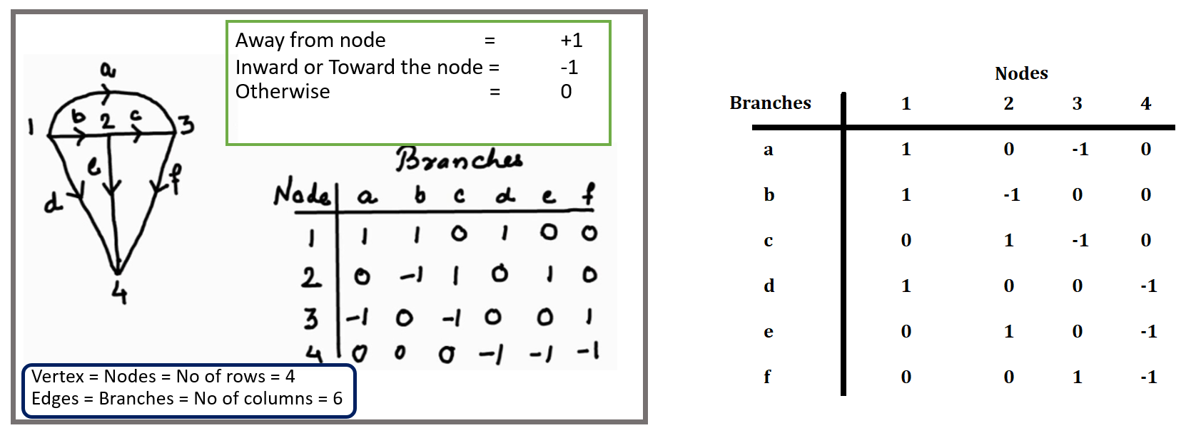
Element-node incidence matrix A^
The incidence of elements to nodes in a connected graph is shown by the element-node incidence matrix. The elements of the matrix are as follows:
1 if the element away from the node.
-1 if the element toward the node.
Otherwise 0.
Sum of any row is equal to zero.
Rank of A^ is < n, where n is number of node
A rank of a graph is n-1, where n is the number of node in the graph.
4-1<4
Incidence matrix A
Element-node incidence matrix A^

Slide 4
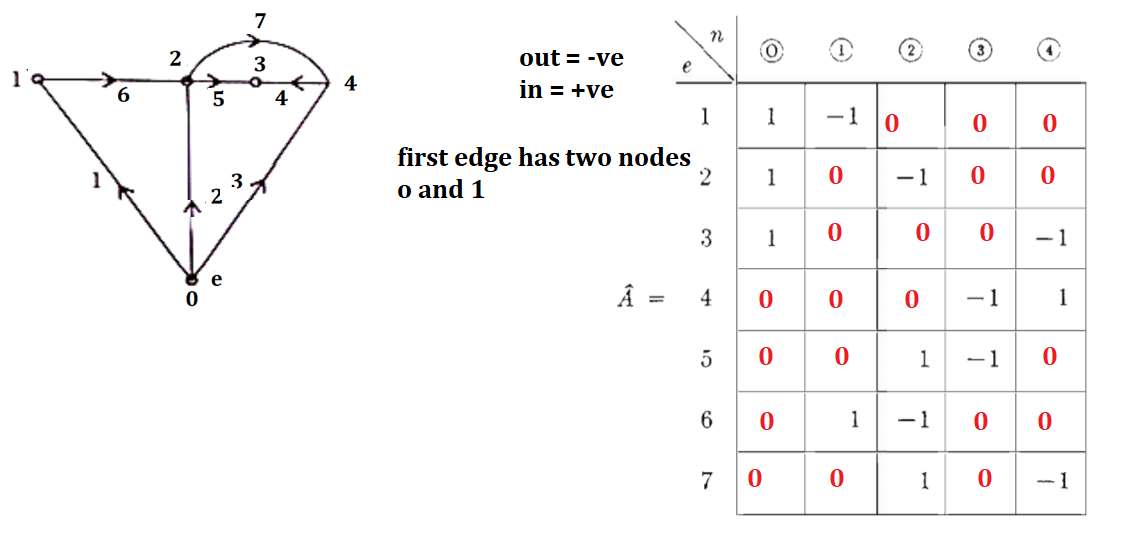
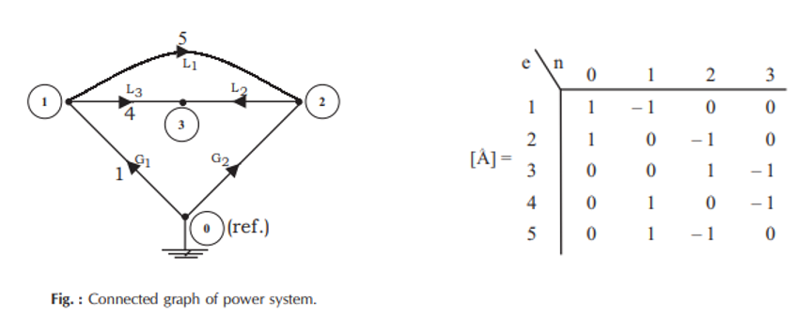
Q: Find the element-node incidence matrix of the graph as shown in Figure given below
Chapter 3 page NO 31

Slide 5
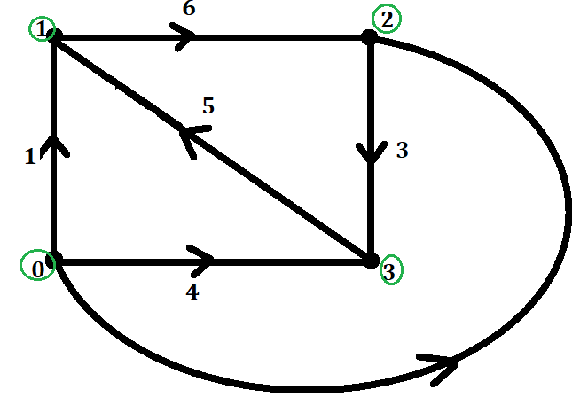
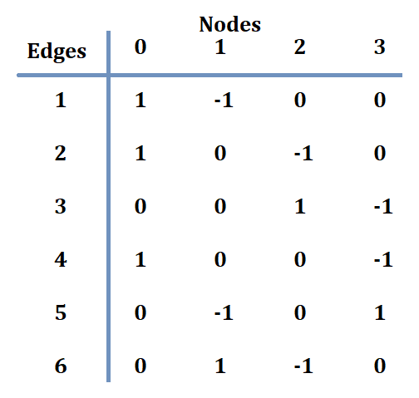
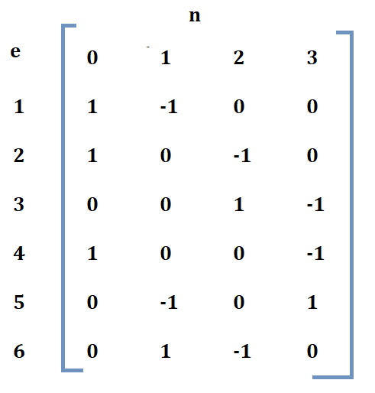
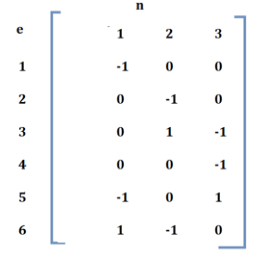
BUS INCIDENCE MATRIX A
Any node of a connected graph can be selected as the reference node. Then, the variables of other nodes, referred to as buses, can be measured with respect to the assigned reference. The matrix obtained from A^ by deleting the column corresponding to the reference node is the element-bus incidence matrix A, which will be called the bus incidence matrix. The dimension of this matrix is e x (n-1).
The dimension of this matrix is e x (n-1) = 6 x (4-1) = 6 x 3.
Node Incidence Matrix = =
Bus Incidence Matrix = A

Slide 6
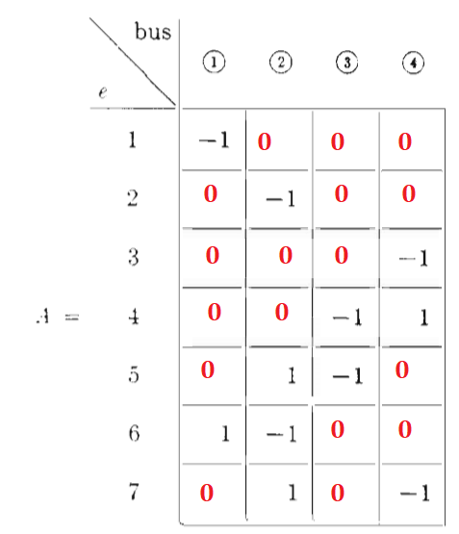
Q: Find the Bus Incidence matrix of the graph as shown in Figure given below
Page No 32

Slide 7
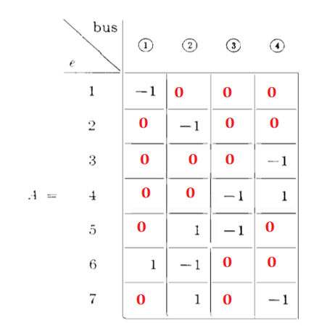
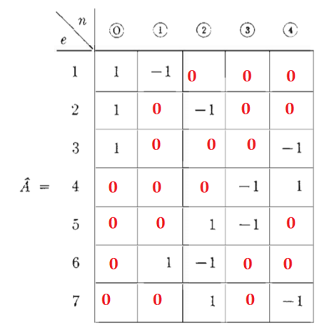
Can we form Node Incidence Matrix From Bus Incidence Matrix?
Yes, you put any value that sum of column is zero
Bus Incidence Matrix Node Incidence Matrix

Slide 8
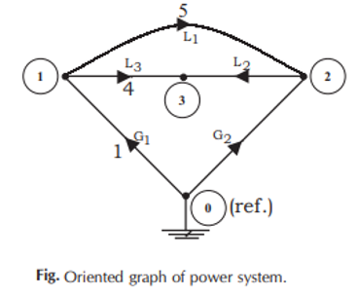
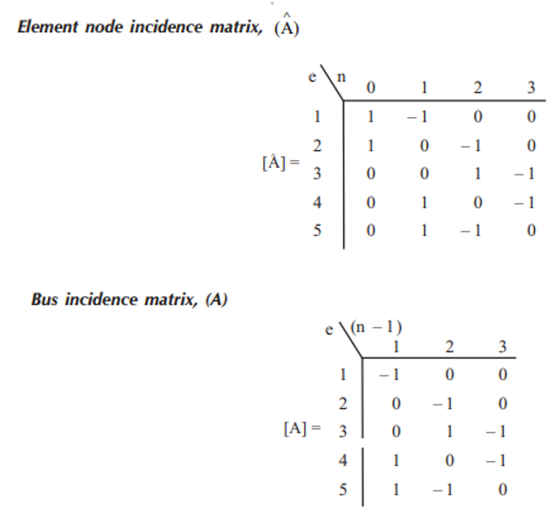
Q: Find the Bus Incidence Matrix of the graph given below

Slide 9
Branch-path incidence matrix K
The incidence of branches to paths in a tree is shown by the branch-path incidence matrix, where a path is oriented from a bus to the reference node. The elements of this matrix are:
1, if the ith branch is in the path from the jth bus(node) to reference and is oriented in the same direction.
-1, if the ith branch is in the path from the jth bus (node) to reference but is oriented in the opposite direction.
0, if the ith branch is not in the path from the jth bus to reference.

Slide 10
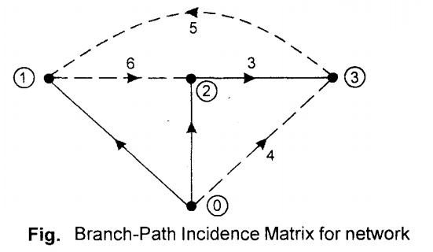
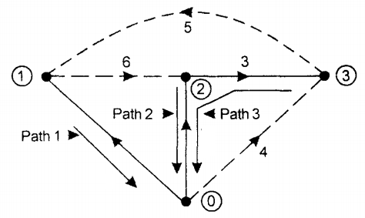
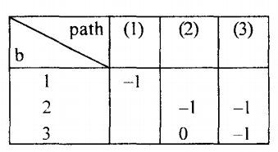
Q: Find the Branch-Path Incidence Matrix of the given directed graph as shown in Figure below:
Path 1 has 1 node
Path 2 has also 1 node
Path 3 has 2 nodes (3 and 2)
0 0
0
0

Slide 11
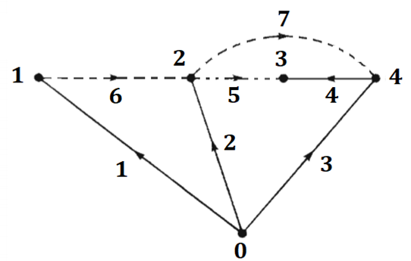
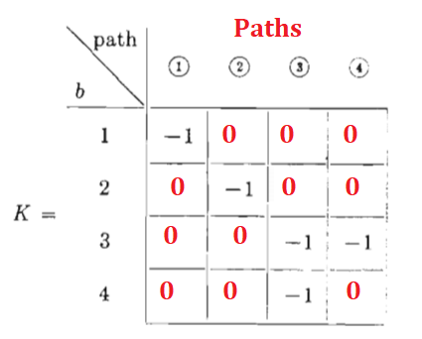
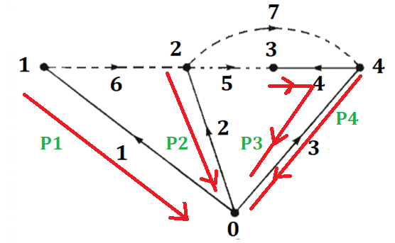
Q: Find the Branch-Path Incidence Matrix of the given directed graph as shown in Figure below:
Same problem page No 33

Slide 12
Basic Cut-Sets
If each cut-set contains only one branch, then these independent cut-sets are called basic cut-sets.
In order to understand basic cut-sets select a tree.
Each basic cut-set contains at least one branch with respect to tree.
1, if the element is incident to and oriented in the same direction as the jth basic cut-set.
-1, if the ith element is incident to and oriented in the opposite direction as the jth basic cut-set.
0, if the ith element is not incident to the jth basic cut-set

Slide 13
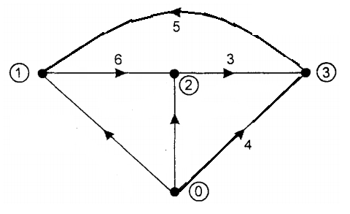
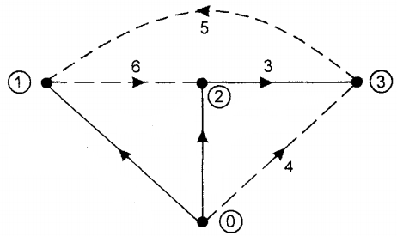
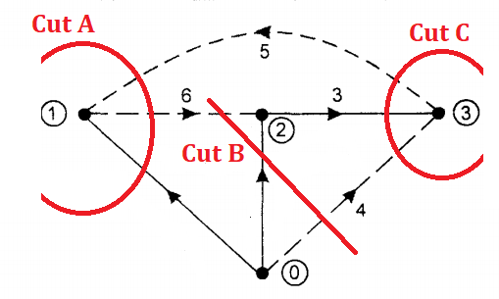
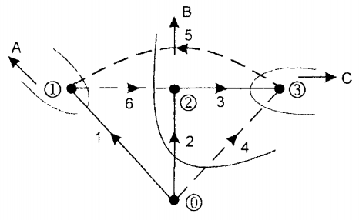
Example: Draw the cuts on the below oriented graph?

Slide 14
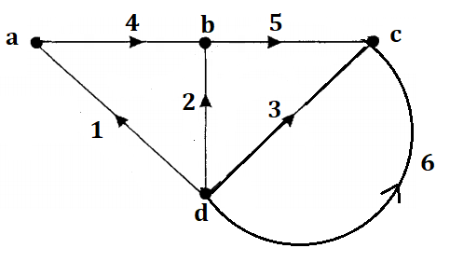
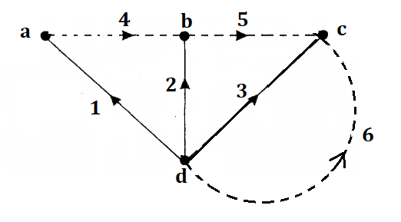
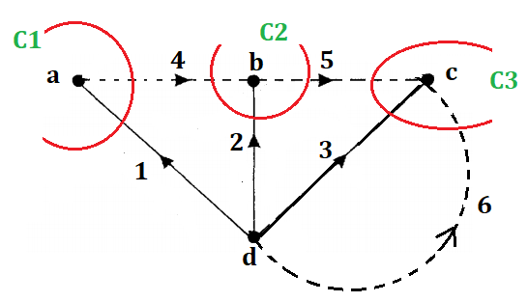
Example: Draw the cuts on the below oriented graph?

Slide 15
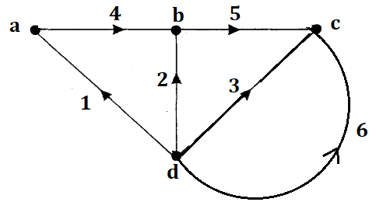
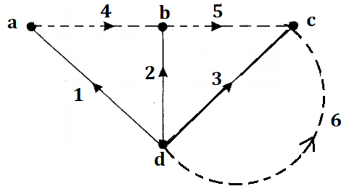
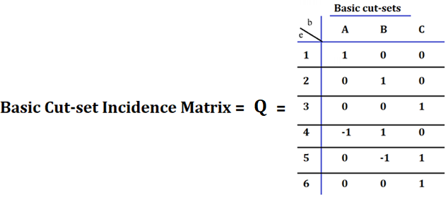
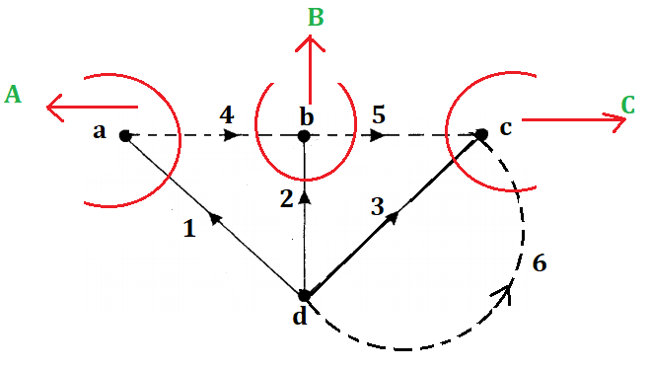
Example: Calculate the Basic Cut-set Incidence Matrix (Q)

Slide 16
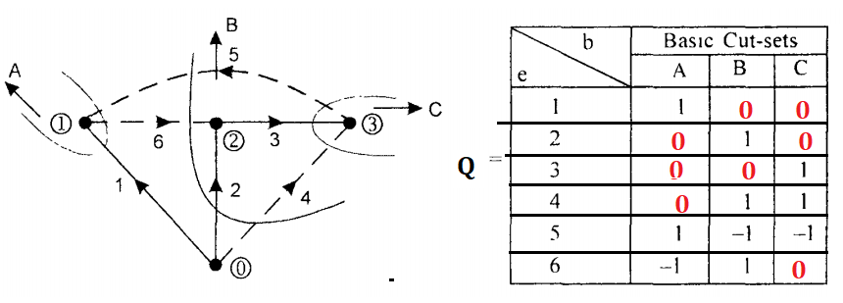
Example: Calculate the Basic Cut-set Incidence Matrix (Q)
Filling column wise, Like Cut-set A has 1, 5, 6 touches, so direction of branch 1 and link 5 is same as Cut set-A direction, than filled 1. similarly link 6 is opposite so it is -1, other filled 0.

Slide 17
Tie Set Matrix (B) OR (Link Currents)
It is a subset of circuit matrix. It is represented by B. OR
It is a set of branches contained in a loop such that each loop contains one link or chord and the remainder are tree branches.
For a given graph, select any tree and remove its all links.
Then replace each link one at a time, it will form a closed path or loop or closed circuit along with some of the tree branches existing.
The circuits formed by replacing each link in tree are called fundamental circuits or f-circuits or tiesets.
Tie set we used KVL equations

Slide 18

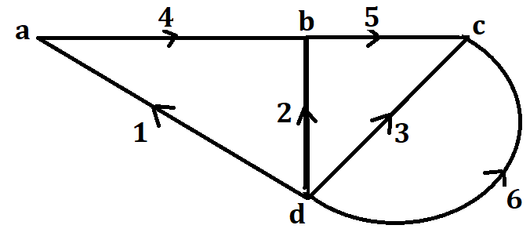
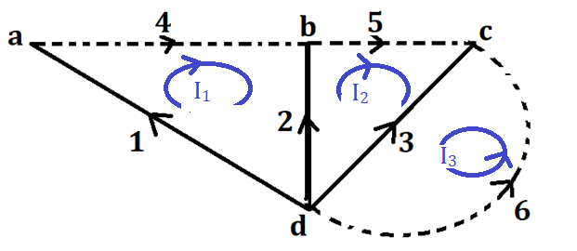
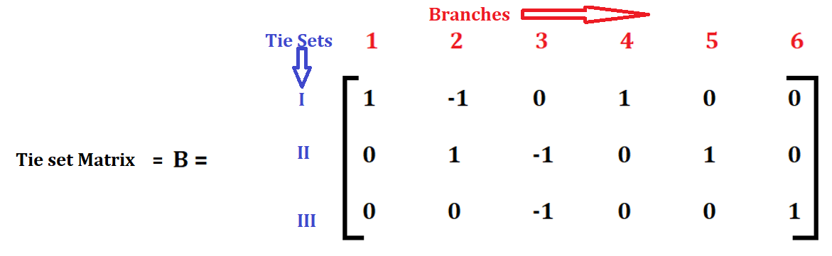

Slide 19
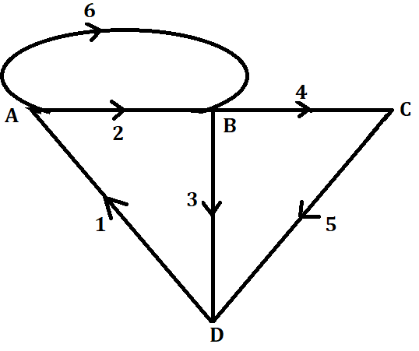
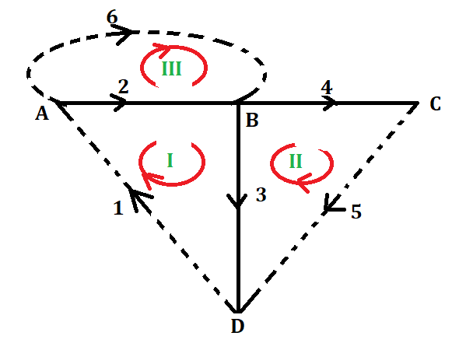
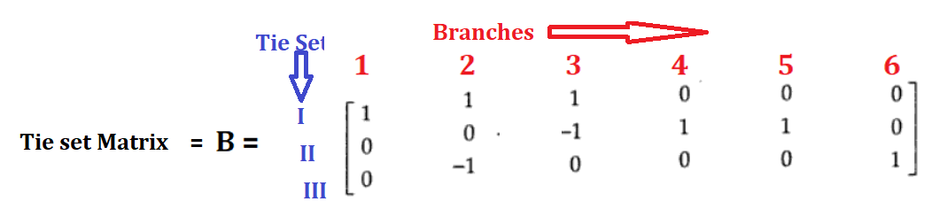

Slide 20
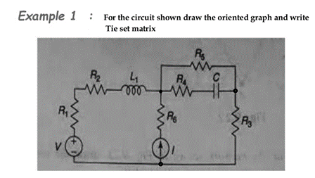
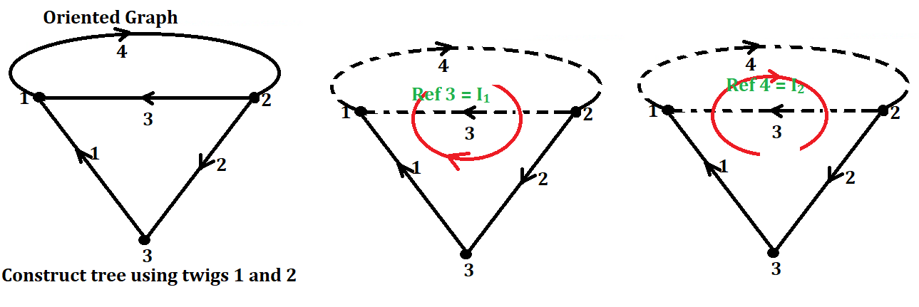
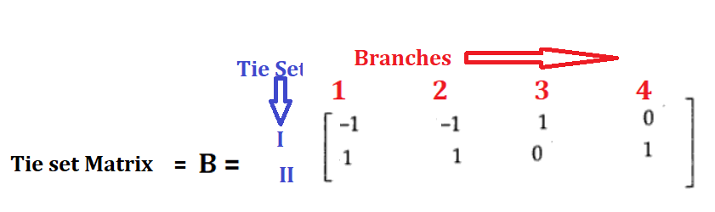

Slide 21
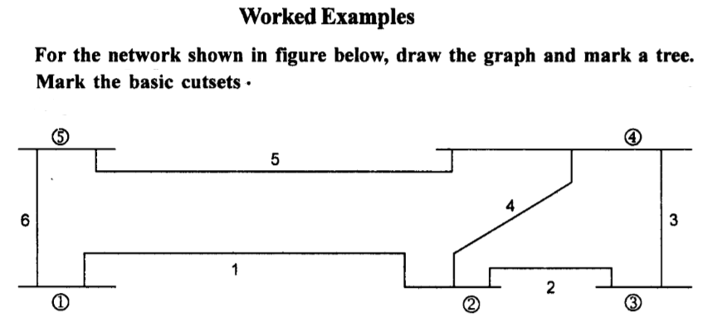
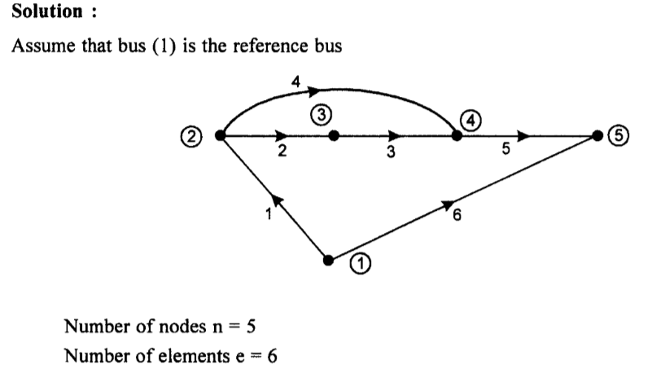
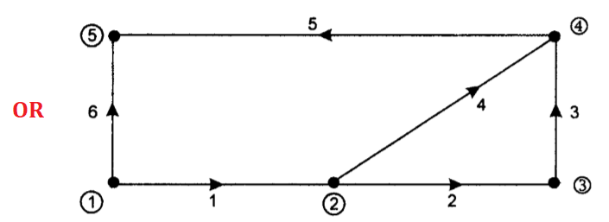
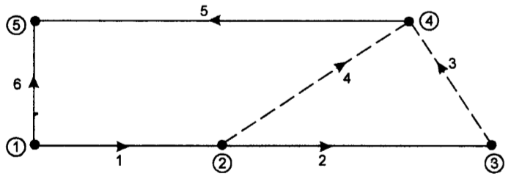
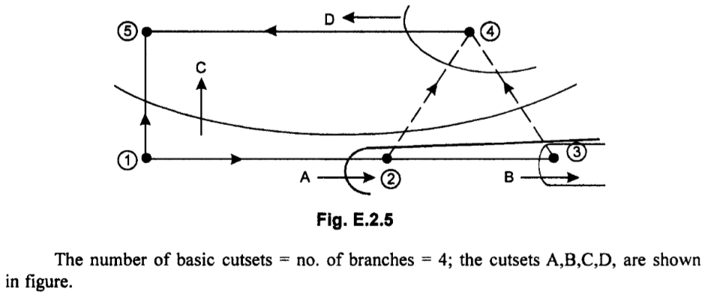
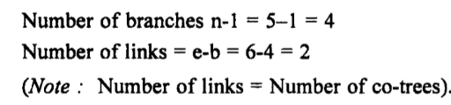

Slide 22
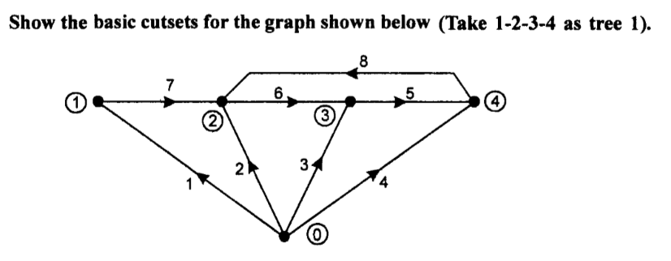
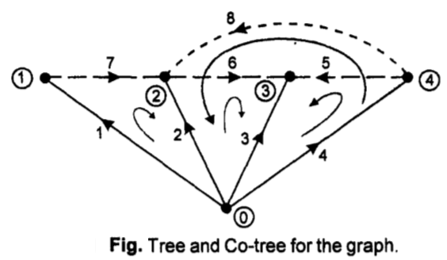
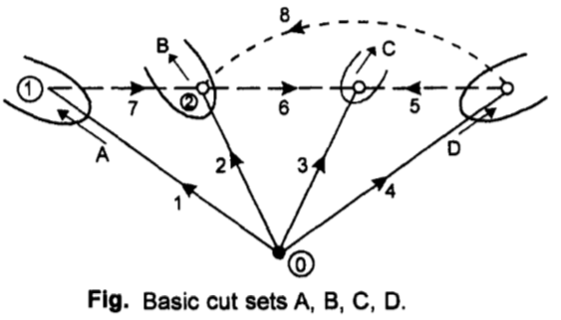

Slide 23
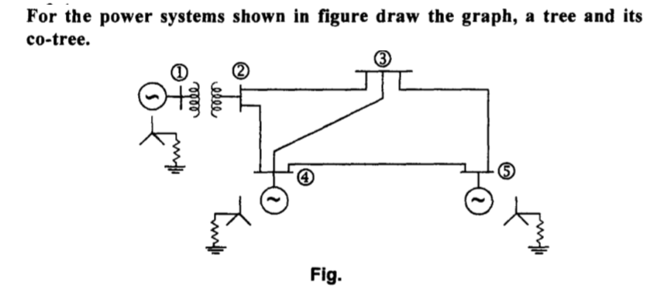
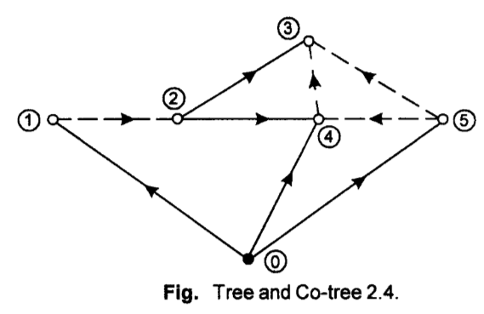


Slide 24


Assignment No: 01
Figure No 1 Figure No 2

Slide 25


Slide 26


Slide 27


Slide 28



Slide 29


Slide 30



Slide 31



Double Click and select only R with resistance 10 ohm

Slide 32


Slide 33



Slide 34





Slide 35


Slide 36




Slide 37




Slide 38




Slide 39



Slide 40




Slide 41



Slide 42



